Slide 1
Microservices (Spring Cloud)
Spring Cloud Config

Slide 2
Topic
What is Spring Cloud Config ?
Toots and IDE
Dependency
Profiles (native and remote)
Kick start native profile

Slide 3
What is Spring Cloud Config ?
Spring Cloud Config provides server-side and client-side support for externalized configuration in a distributed system. With the Config Server, you have a central place to manage external properties for applications across all environments. The concepts on both client and server map identically to the Spring Environment and PropertySource abstractions, so they fit very well with Spring applications but can be used with any application running in any language.

Slide 4
Toots and IDE
IDE - Eclipse
Build Tool – maven
Server – embedded tomcat

Slide 5
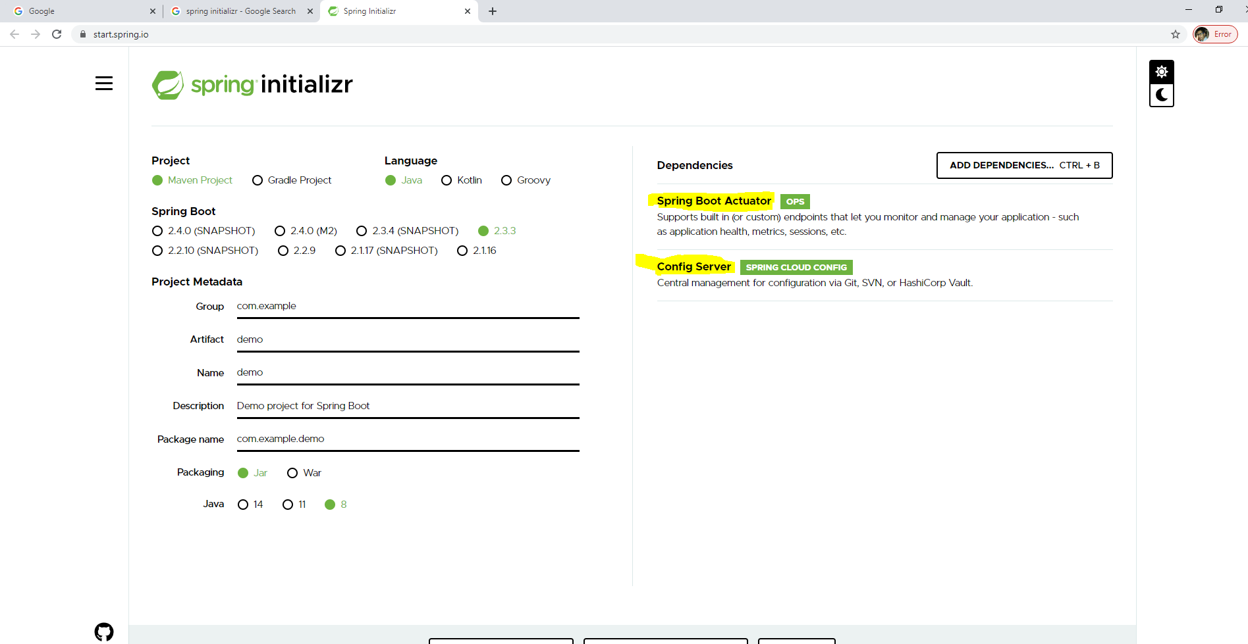
Dependency

Slide 6
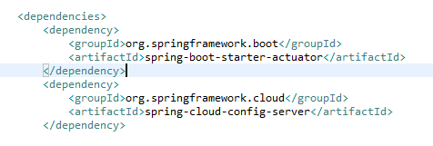

Slide 7
Profiles (native and remote)
Can Store configuration locally or in remote (i.e github, bitbucket)

Slide 8
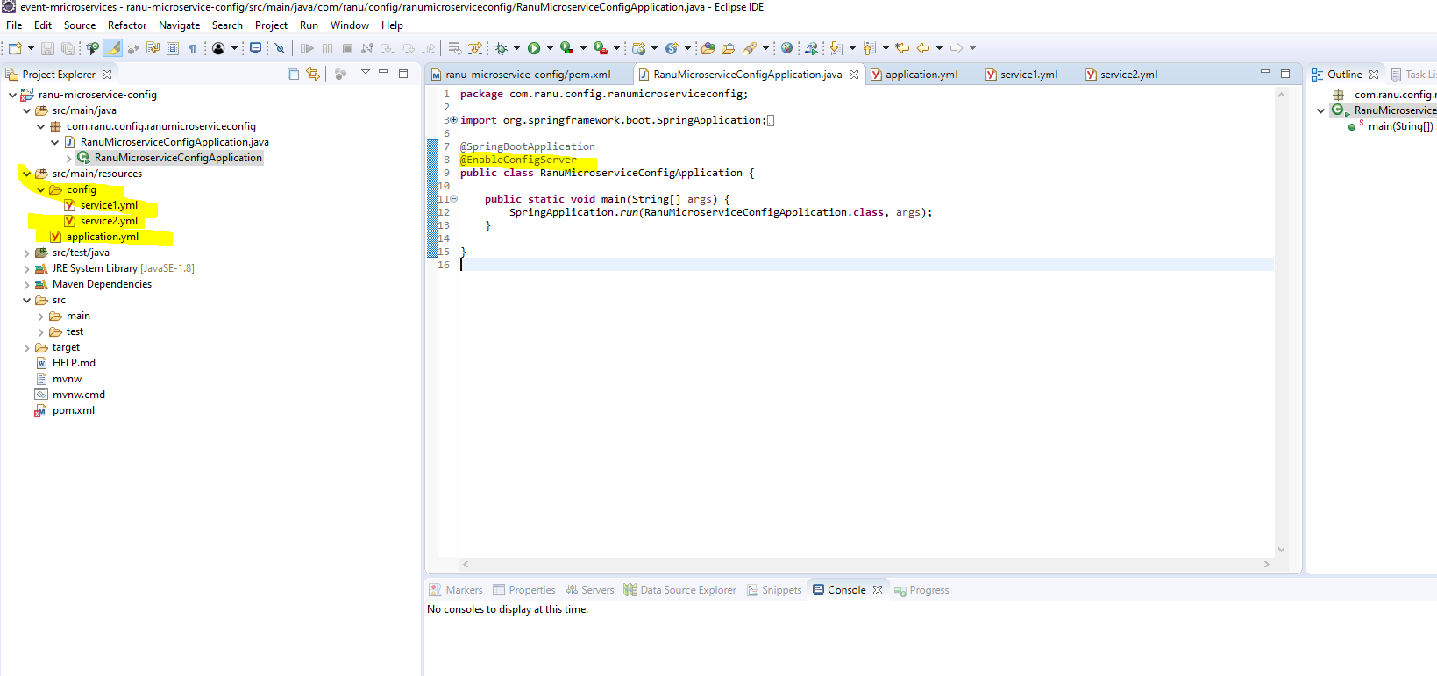
Native profile

Slide 9
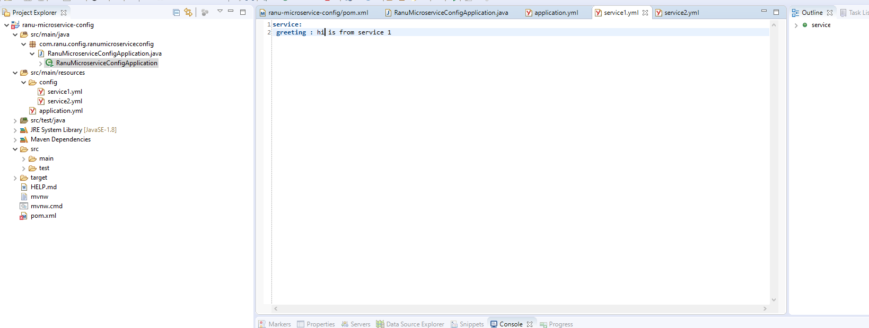
Service 1 yml

Slide 10
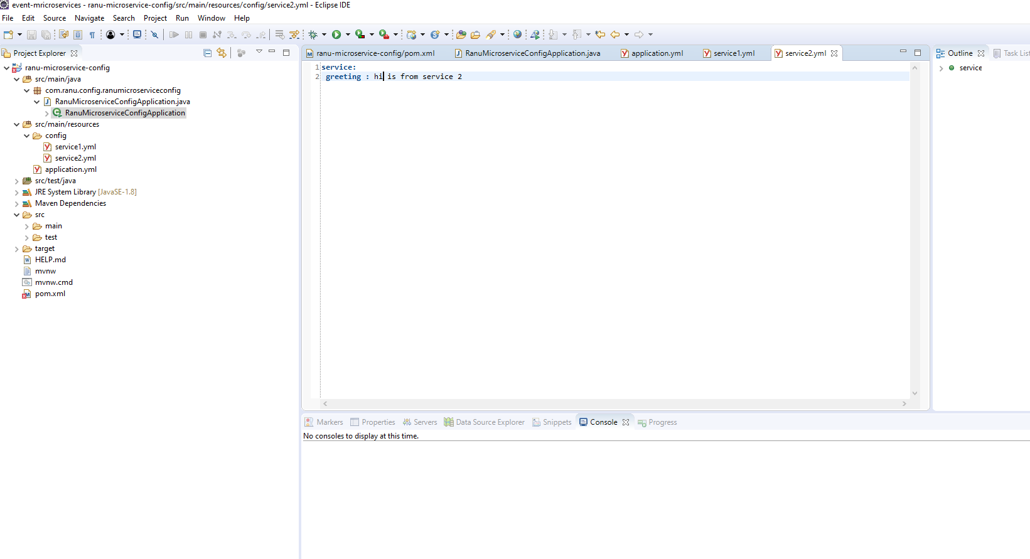
Service 2 yml

Slide 11
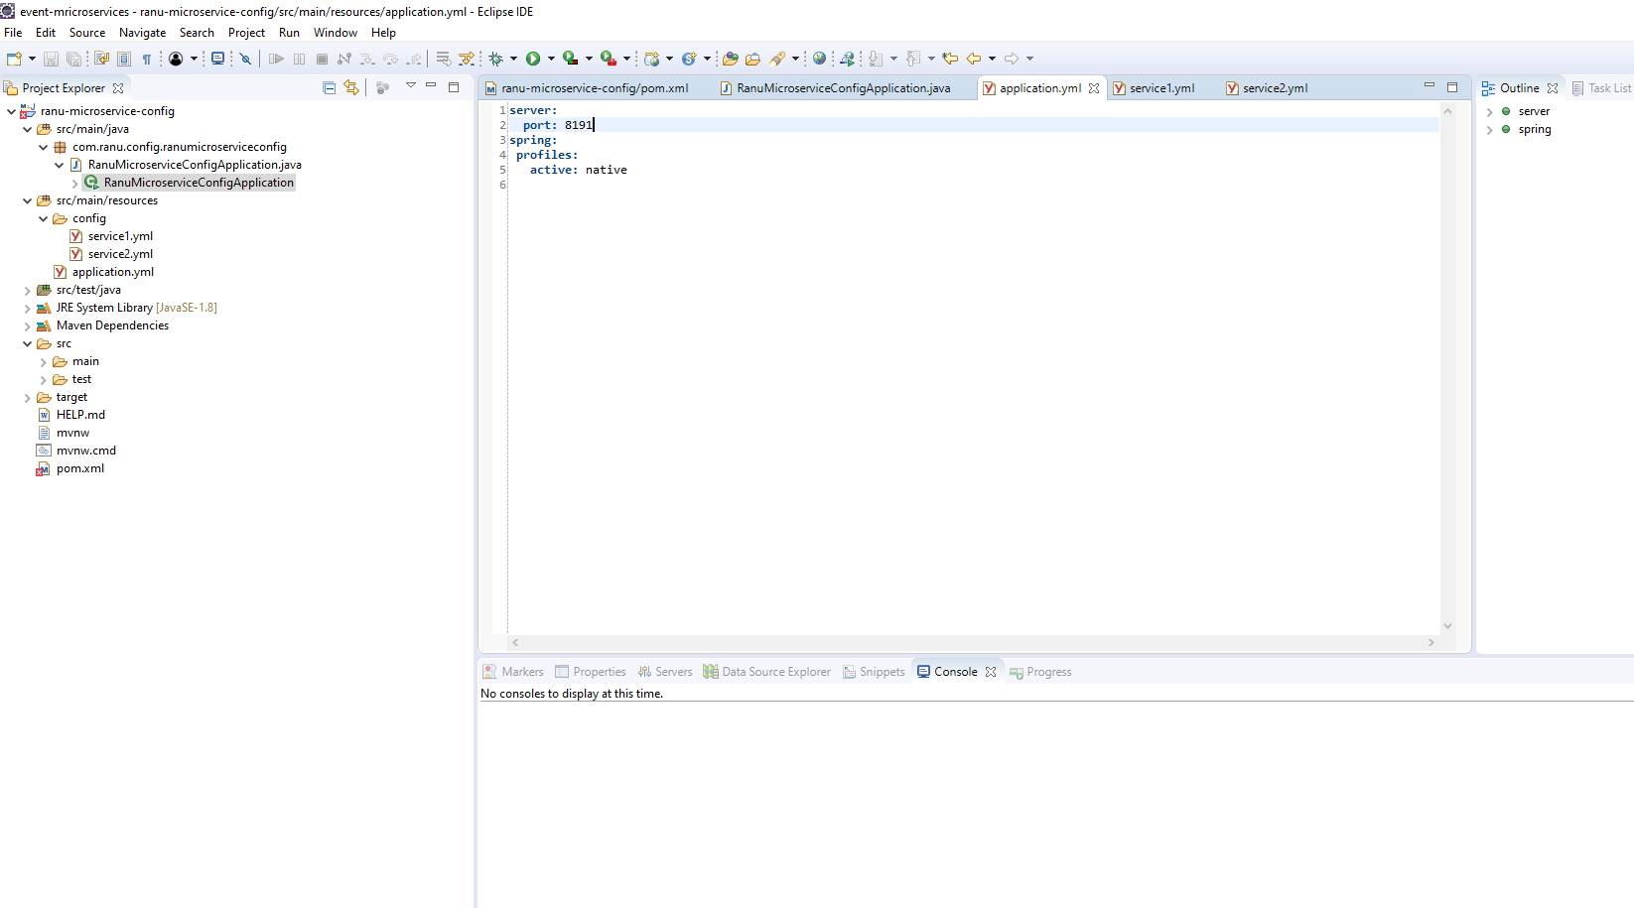
application.yml

